Slide 1
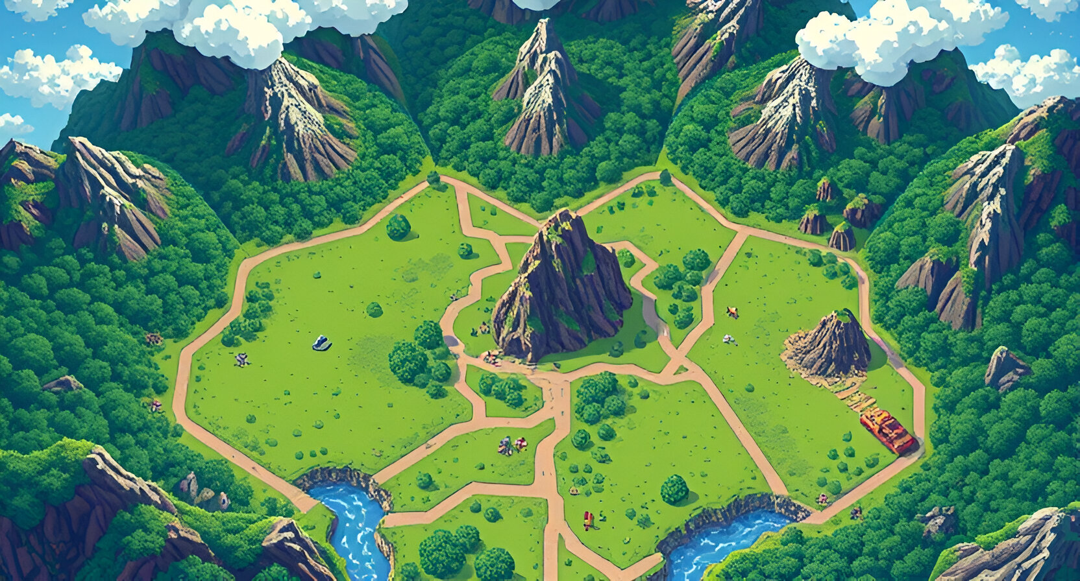

Adventurer's Arena
A Two-Player Strategy Board Game
By Team: ArenaShapers
Members:
Shiv Shakti Rai Abhishek Goyal

Slide 2
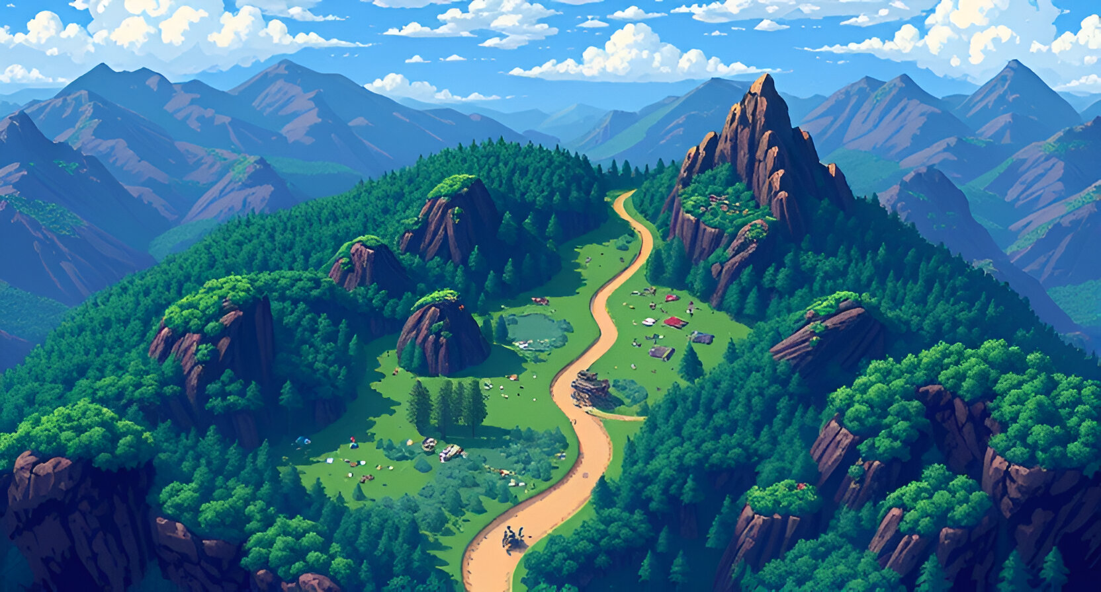
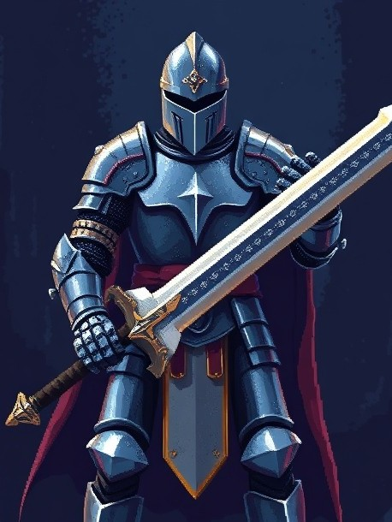
What is Adventurer's Arena?
Adventurer's Arena is a strategic two-player, turn-based board game that emphasizes skillful planning, piece management, and tactical combat.
Turn-Based Strategy: Each player takes turns deploying, moving, or attacking with their pieces on the battlefield.
Board of Battlefield: The board’s layout encourages players to think strategically about positioning, as adjacency, unoccupied nodes, and movement range dictate possible actions.

Slide 3
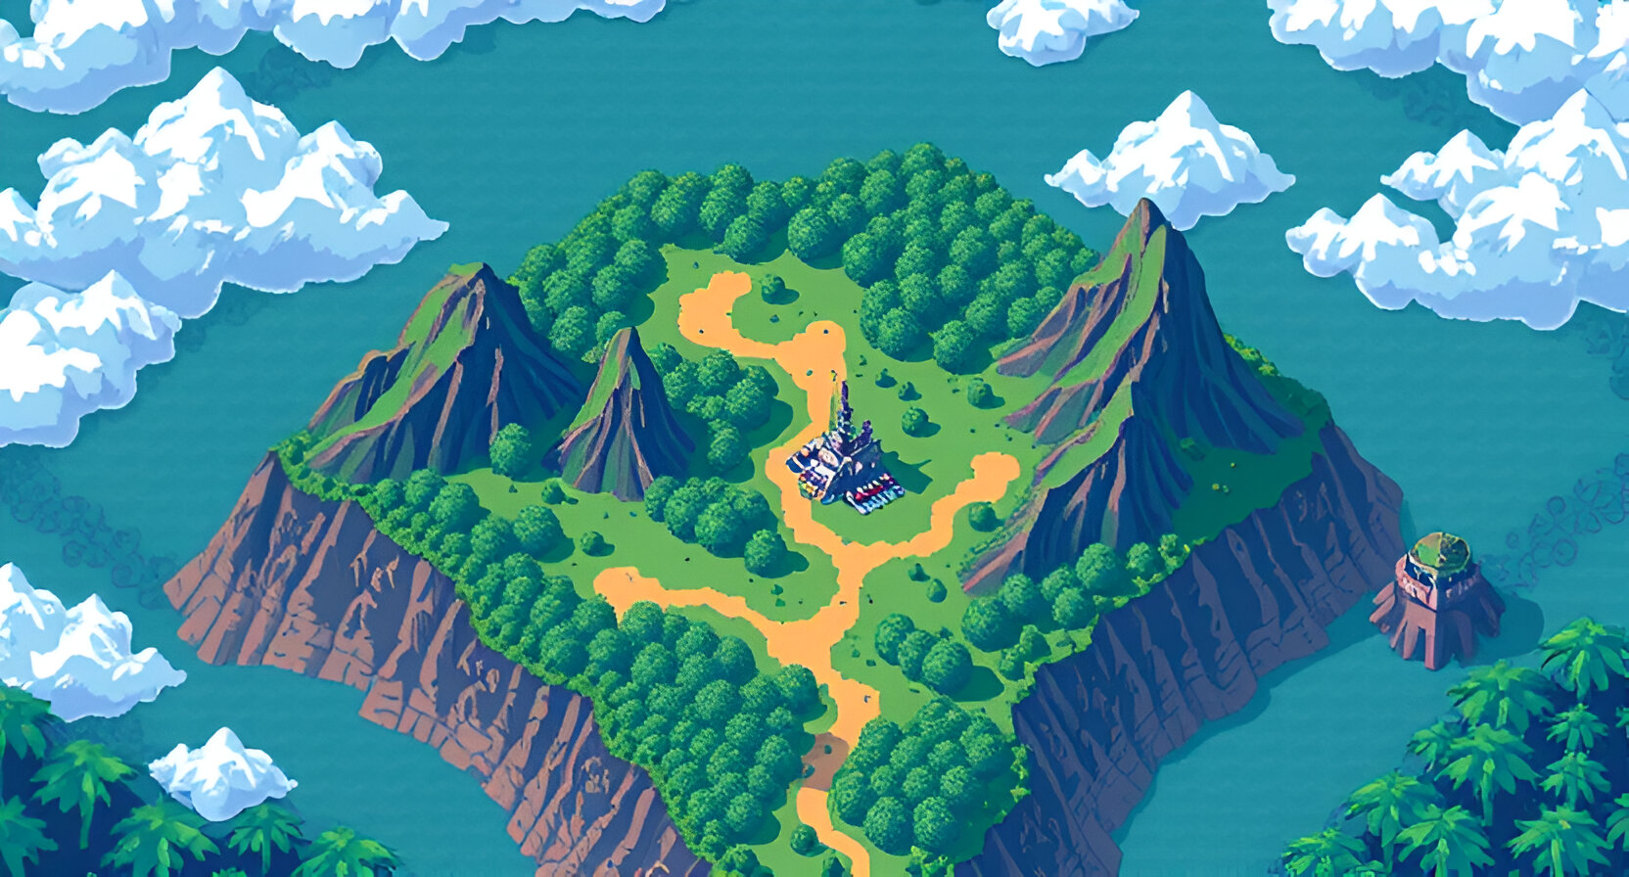

Why Create Adventurer's Arena?
Modernizing Classics: Combines the nostalgia of classic board games with unique pieces.
Accessibility: Can be played anywhere with anyone
Skill Development: Enhances critical thinking, strategy, and creativity.
Rising Demand: Aligns with the growing trend of web3-based gaming

Slide 4
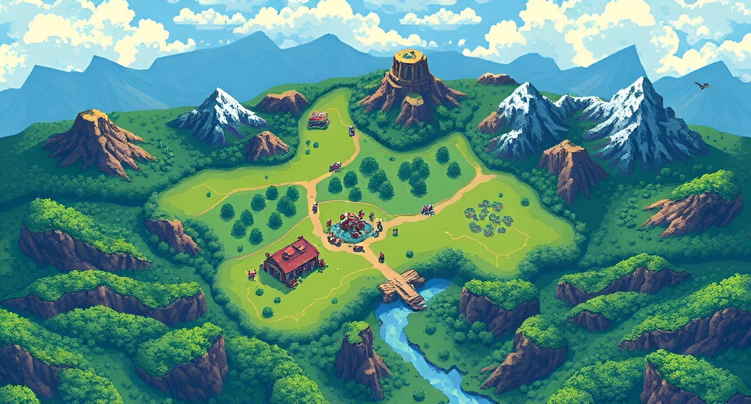
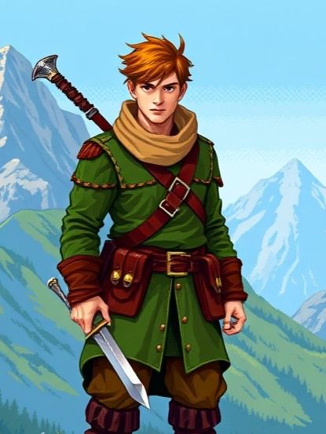
Tech Stack
Frontend:
Vite( React ): For creating an engaging and interactive user interface.
React Router: Enables smooth navigation across game features.
Backend:
Node.js: Handles real-time gameplay mechanics, room creation, and endpoints.
Express: Manages HTTP server functionality
Socket.io: Facilitates real-time communication for multiplayer gameplay.

Slide 5
Tech Stack
Smart Contracts and blockchain:
Foundry: Creation, testing and deployment of smart contracts
Etherlink Testnet: The chain on which the game is deployed
Blockchain Connection:
Ethers: Setting up connection to contracts.
Alchemy SDK: Integration of Shape Keys NFTs.

Slide 6
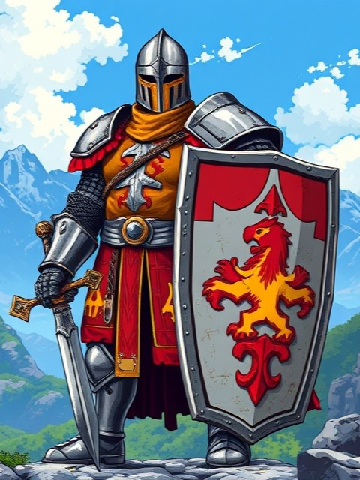
Game Features ( Web2 )
Room-based gameplay: One player creates a room, Other joins using a room code.
Pieces deployment mechanics and battle mechanics.
Unique abilities of each piece and engaging combat system.
Interactive and thematic UI.

Slide 7

Game Features ( Web3 )
Collaboration: High Potential for collaboration with other web3 games.
Buy the skins you like through pure blockchain interaction
Shape Keys: Got those Shape Keys? There is a unique map waiting for you.
Registering Winner: Both agree on winning of a player? Let the blockchain know!

Slide 8
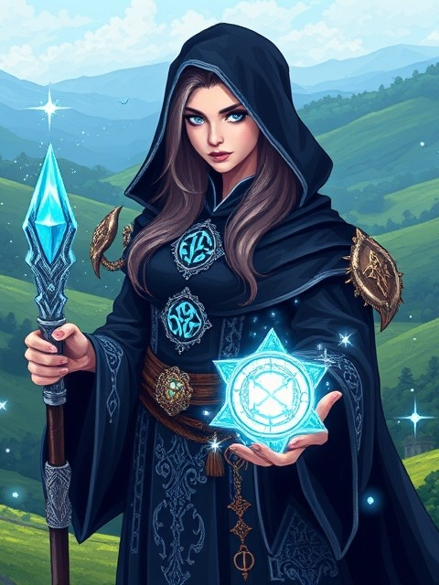
Playing The Game
Github Repo : https://github.com/Abhishekgoyal007/Adventurers-Arena
Deployed Site : https://adventurers-arena.vercel.app
You can clone the repo to work on your local machine or go to the site to play for yourself.
Basic Instructions are present on ‘How to Play’ on Home screen of the app.

Slide 9
Go ahead! Find an opponent!
Let the Arena awaken!

